Slide 1
Secure data hiding in images using steganography
CAPSTONE PROJECT
Presented By: Tanvi D Gunjal
College Name & Department : Vishwakarma Institute of Technology, Pune,
Computer Engineering Department

Slide 2
OUTLINE
Problem Statement
Technology used
Wow factor
End users
Result
Conclusion
Git-hub Link
Future scope

Slide 3
Problem Statement
Traditional encryption raises suspicion due to its visibility. This project uses steganography to securely hide text inside image metadata without altering the image. A password-protected system ensures only authorized users can retrieve the hidden message, enhancing data privacy and security.

Slide 4
Technology used
Programming Language: Python
Libraries & Frameworks
Pillow (PIL) – Image processing
Hashlib – Password hashing
Base64 – Encoding & decoding
Development Tools:
IDE: VS Code
Version Control: Git & GitHub

Slide 5
Wow factors
🔥 Lightweight & Efficient ;
Uses image metadata for text storage without altering image quality.
🔐 Password-Protected Encryption ;
Ensures only authorized users can retrieve hidden messages.
📂 Lossless Steganography :
The original image remains visually unchanged after encryption.
⚡ Quick & Simple :
Minimal dependencies and easy-to-use interface for encoding/decoding.
📜 Future-Ready :
Can be extended with GUI, stronger encryption, or AI-based detection.

Slide 6
End users
Cybersecurity Enthusiasts
Learn and experiment with steganography techniques.
Privacy-Conscious Users
Securely hide sensitive messages in images.
Students & Researchers
Use it as a foundation for academic projects on encryption & steganography.
Forensic Experts
Analyse and detect hidden messages in digital images.

Slide 7
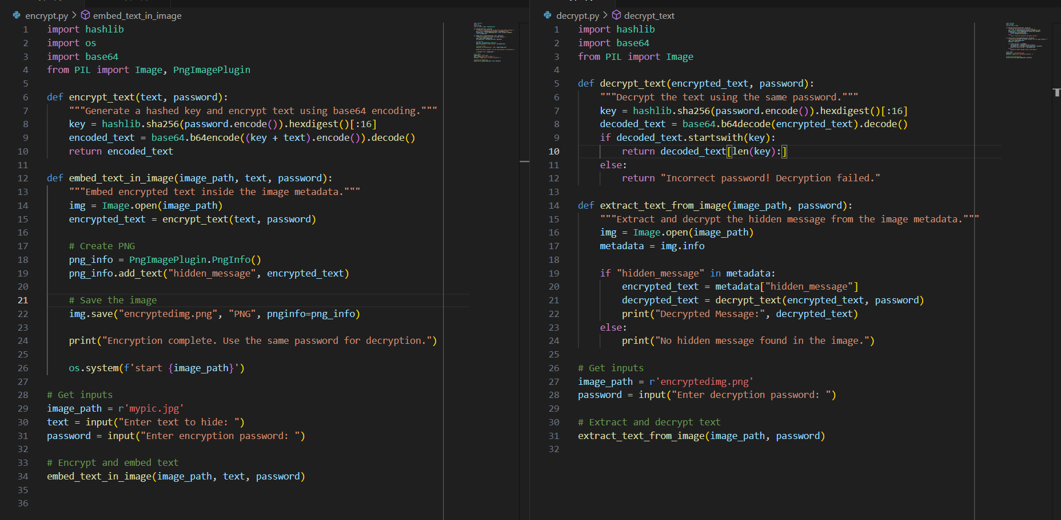
Results
Fig 1 : Encryption and Decryption Code

Slide 8
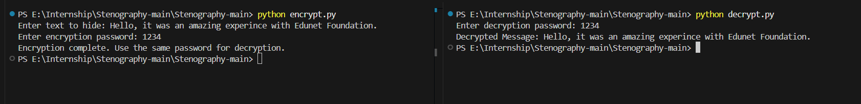


Results
Output :
Fig 2: Output of encrypt.py
Fig 4: Output of decrypt.py
Fig 3 : Original Image
Fig 5 : Encrypted Image

Slide 9
Conclusion
This project enables secure text hiding in images using password-based encryption.
It ensures data confidentiality while keeping the image visually unchanged.
The approach is lightweight, efficient, and easy to implement for various applications.

Slide 10
GitHub Link
Here is the GitHub Repository link for my project !! https://github.com/tgunjal0421/Steganography-Project.git

Slide 11
Future scope
Automated Batch Processing : Enable encryption/decryption for multiple images at once.
Stronger Encryption : Implement AES or hybrid encryption for enhanced security.
AI-Based Detection : Train AI models to detect hidden messages and prevent steganography attacks.
Mobile & Web Integration : Develop a mobile app or web-based tool for accessibility.
Customizable Storage Options : Allow users to choose where hidden data is embedded (metadata, pixels, or alternate layers).

Slide 12
THANK YOU !!!

